Slide 1
Spring4
2017

Slide 2
Spring4

Slide 3
Agenda
Spring Cache
1
@PropertySource, @Value with Environment
2
Profiling - @Profile
3
XML and Annotations
4

Slide 4
Spring 4 Cache
Adding Caching in your Spring based application is rather trivial.
Caching solutions available in market:
EhCache
Guava Cache
Caffeine Cache
Oscache
JBoss Cache

Slide 5
Cache Abstraction
Spring Cache Abstraction is a set of interfaces and annotations,
Used for applying caching to Java methods.
Cache the returned value of a method for a given input[method argument e.g.], and for any further request with same input, return the result from cache without even executing the method
Reducing the number of executions.
Cache Interfaces in Spring:
org.springframework.cache.Cache
org.springframework.cache.CacheManager
Spring provides few out of the box abstraction implementations:
JDK java.util.concurrent.ConcurrentMap based caches, EhCache, Caffeine, Gemfire cache, Guava caches and JSR-107 compliant caches.

Slide 6
Caching Annotations
@Cacheable : triggers cache population
@CacheEvict : triggers cache eviction
@CachePut : updates the cache without interfering with the method execution
@Caching : regroups multiple cache operations to be applied on a method
@CacheConfig : shares some common cache-related settings at class-level
@EnableCaching : Configuration level annotation which enables Caching

Slide 7
Environment Abstraction - @Profile, @PropertySource
Spring @PropertySource annotations is mainly used to read from properties file using Spring’s Environment interface.
This annotation is in practice, placed on @Configuration classes.
Spring @Value annotation can be used to specify expression on field or methods. Common use case is to specify the property from a .properties file along with default value.

Slide 8
Environment Abstraction - @Profile, @PropertySource
<?xml version="1.0" encoding="UTF-8"?>
<beans xmlns="http://www.springframework.org/schema/beans"
xmlns:xsi="http://www.w3.org/2001/XMLSchema-instance"
xmlns:context="http://www.springframework.org/schema/context"
xsi:schemaLocation="http://www.springframework.org/schema/beans http://www.springframework.org/schema/beans/spring-beans-4.0.xsd
http://www.springframework.org/schema/context http://www.springframework.org/schema/context/spring-context-4.0.xsd">
<context:component-scan base-package=“org.cap"/>
<bean class="org.springframework.context.support.PropertySourcesPlaceholderConfigurer">
<property name="ignoreUnresolvablePlaceholders" value="true"/>
<property name="locations">
<list>
<value>classpath:application.properties</value>
</list>
</property>
</bean>
</beans>

Slide 9
Environment Abstraction - @Profile, @PropertySource(contd.)
@Configuration
@ComponentScan(basePackages = “org.cap")
@PropertySource(value = { "classpath:application.properties" })
public class AppConfig {
}
@Bean
public static PropertySourcesPlaceholderConfigurer propertySourcesPlaceholderConfigurer() {
return new PropertySourcesPlaceholderConfigurer();
}

Slide 10

SPRING PROFILES

Slide 11

Spring Profiles
Part of Spring Framework since 3.0
Allow multiple different configurations
Select the ones you want by selecting one or more profiles
integrated into Spring Testing framework also
Beans can be grouped into Profiles
Profiles can represent purpose: "web", "offline"
Or environment: "dev","qa","uat","prod","cloud"
Or implementation: "jdbc","jpa"
Beans included /excluded based on profile membership

Slide 12
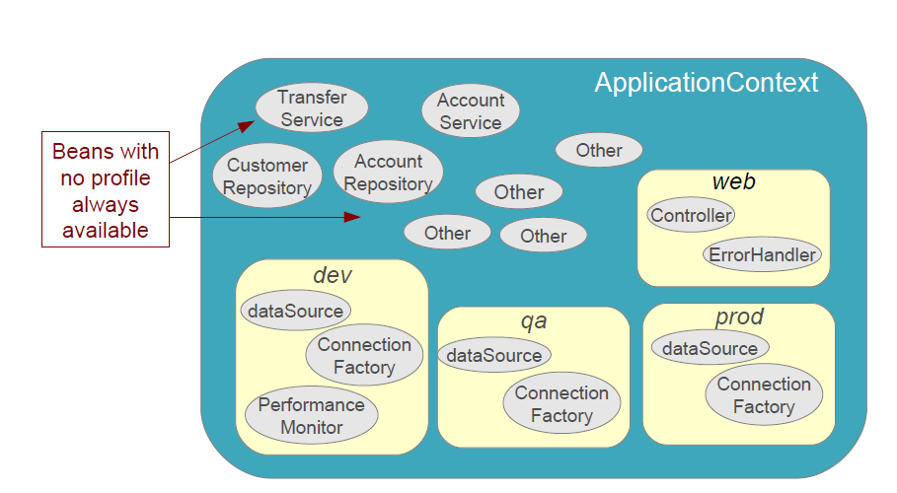
Example Profiles

Slide 13
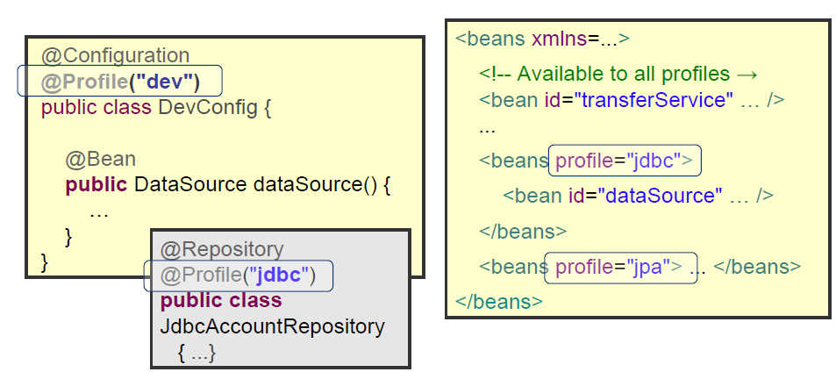
Defining profiles
Add @Profile annotation to component or configuration
Or qualify <beans> in XML

Slide 14
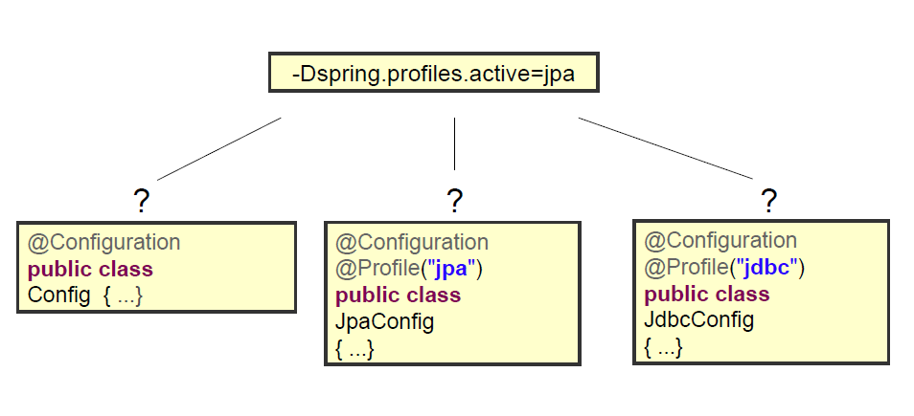
QUIZ
Which of the following is/are selected?

Slide 15
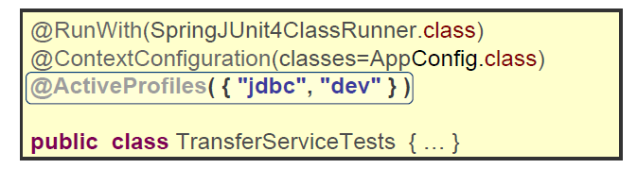
Activating Profiles For a Test
@ActiveProfiles inside Spring-driven test class
Define one or more profiles
Beans associated with that profile are instantiated
Also beans not associated with any profile
Example: Two profiles activated -jdbc and dev

Slide 16
Active Profiles
Profiles may be activated at execution-time
System property

Slide 17
Profiling
<?xml version="1.0" encoding="UTF-8"?> <beans xmlns="http://www.springframework.org/schema/beans" xmlns:xsi="http://www.w3.org/2001/XMLSchema-instance" xsi:schemaLocation="http://www.springframework.org/schema/beans http://www.springframework.org/schema/beans/spring-beans-4.0.xsd"> <bean id="dataSource" class="org.springframework.jdbc.datasource.DriverManagerDataSource"> <property name="driverClassName" value="com.mysql.jdbc.Driver" /> <property name="url" value="jdbc:mysql://localhost:3306/capdemo" /> <property name="username" value="myuser" /> <property name="password" value="mypassword" /> </bean> </beans>

Slide 18
Profiling
<?xml version="1.0" encoding="UTF-8"?>
<beans xmlns="http://www.springframework.org/schema/beans"
xmlns:xsi="http://www.w3.org/2001/XMLSchema-instance"
xsi:schemaLocation="http://www.springframework.org/schema/beans http://www.springframework.org/schema/beans/spring-beans-4.0.xsd">
<bean id="dataSource" class="org.springframework.jdbc.datasource.DriverManagerDataSource">
<property name="driverClassName" value=" oracle.jdbc.driver.OracleDriver" />
<property name="url" value="jdbc:oracle:thin:@PRODHOST:PRODPORT/capdemo" />
<property name="username" value="myproduser" />
<property name="password" value="myprodpassword" />
</bean>
</beans>

Slide 19
Profiling
<?xml version="1.0" encoding="UTF-8"?>
<beans xmlns="http://www.springframework.org/schema/beans"
xmlns:xsi="http://www.w3.org/2001/XMLSchema-instance"
xmlns:context="http://www.springframework.org/schema/context"
xsi:schemaLocation="http://www.springframework.org/schema/beans http://www.springframework.org/schema/beans/spring-beans-4.0.xsd
http://www.springframework.org/schema/context http://www.springframework.org/schema/context/spring-context-4.0.xsd">
<context:component-scan base-package=“org.cap"/>
<beans profile="Development">
<import resource="dev-config-context.xml"/>
</beans>
<beans profile="Production">
<import resource="prod-config-context.xml"/>
</beans>
</beans>
AbstractApplicationContext context = new ClassPathXmlApplicationContext("app-config.xml");
//Sets the active profiles
context.getEnvironment().setActiveProfiles("Development");
/*
* Perform any logic here
*/
context.close();

Slide 20
Summary
Spring Cache
@PropertySource
@Profile
Environment

Slide 21
Transaction Management

Slide 22
Transaction Management
A database transaction is a sequence of actions that are treated as a single unit of work.
Complete entirely or take no effect at all.
Transaction management is an important part of and RDBMS
Ensure data integrity and consistency.
ACID:
Atomicity
Consistency
Isolation
Durability

Slide 23
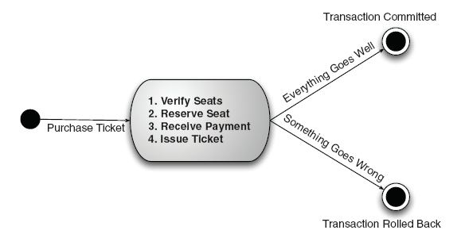
Transaction Management

Slide 24
Local vs. Global Transactions
Local Transactions
Global Transactions

Slide 25
Programmatic vs. Declarative
Programmatic transaction management:
This means that you have manage the transaction with the help of programming. That gives you extreme flexibility, but it is difficult to maintain.
Declarative transaction management:
This means you separate transaction management from the business code. You only use annotations or XML based configuration to manage the transactions.

Slide 26
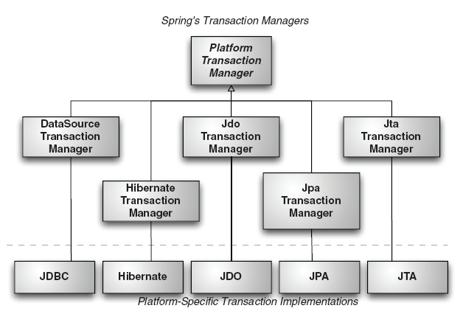
Spring Transaction Management Support

Slide 27
PlatformTransactionManager
public interface PlatformTransactionManager {
TransactionStatus getTransaction(TransactionDefinition definition);
throws TransactionException;
void commit(TransactionStatus status) throws TransactionException;
void rollback(TransactionStatus status) throws TransactionException;
}

Slide 28
TransactionDefinition
public interface TransactionDefinition {
int getPropagationBehavior();
int getIsolationLevel();
String getName();
int getTimeout();
boolean isReadOnly();
}

Slide 29
TransactionStatus
public interface TransactionStatus extends SavepointManager {
boolean isNewTransaction();
boolean hasSavepoint();
void setRollbackOnly();
boolean isRollbackOnly();
boolean isCompleted();
}

Slide 30
AOP

Slide 31
AOP in SpringFramework
Breaking down program logic into distinct parts called so-called concerns.
Cross-cutting concerns and these cross-cutting concerns are conceptually separate from the application's business logic.
Examples of aspects like logging, auditing, declarative transactions, security, and caching etc.
Notes:
The key unit of modularity in OOP is the class, whereas in AOP the unit of modularity is the aspect. Dependency Injection helps you decouple your application objects from each other and AOP helps you decouple cross-cutting concerns from the objects that they affect. AOP is like triggers in programming languages such as Perl, .NET, Java and others.
Spring AOP module provides interceptors to intercept an application, for example, when a method is executed, you can add extra functionality before or after the method execution.

Slide 32
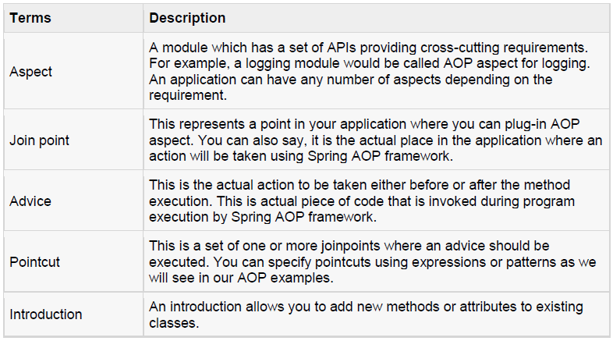
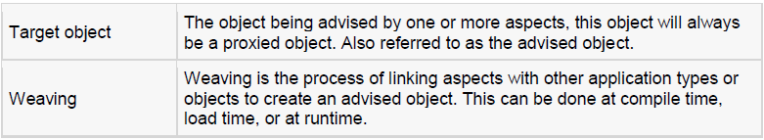
AOP Terminologies

Slide 33
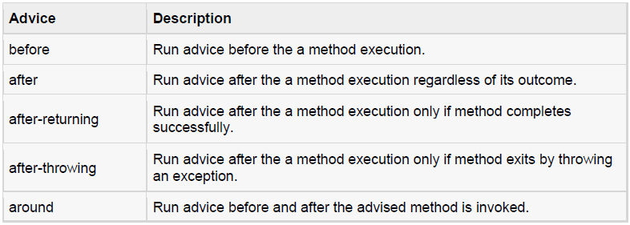
Types of Advice
Spring aspects can work with five kinds of advice mentioned below:
Notes:
Refer Lab 1.12 to implement different types of AOP.

Slide 34
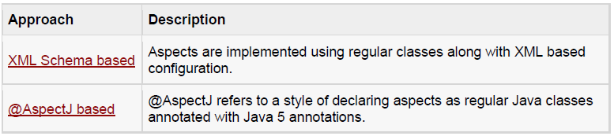
Custom Aspects Implementation
Notes:
Spring supports the @AspectJ annotation style approach and the schema-based approach to implement custom aspects. These two approaches have been explained in detail in the following two sub chapters

Slide 35
XML Schema Based AOP with Spring
We need to import the spring-aop schema as described below:
<?xml version="1.0" encoding="UTF-8"?>
<beans xmlns="http://www.springframework.org/schema/beans"
xmlns:xsi="http://www.w3.org/2001/XMLSchema-instance"
xmlns:aop="http://www.springframework.org/schema/aop"
xsi:schemaLocation="http://www.springframework.org/schema/beans
http://www.springframework.org/schema/beans/spring-beans-3.0.xsd
http://www.springframework.org/schema/aop
http://www.springframework.org/schema/aop/spring-aop-3.0.xsd ">
<!-- bean definition & AOP specific configuration -->
</beans>
Notes:
You will also need following AspectJ libraries on the CLASSPATH of your application. These libraries are available in the 'lib' directory of an AspectJ installation, otherwise you can download them from the internet.
• aspectjrt.jar
• aspectjweaver.jar
• aspectj.jar

Slide 36
Declaring an aspect
An aspect is declared using the <aop:aspect> element, and the backing bean is referenced using the ref attribute as follows:
<aop:config>
<aop:aspect id="myAspect" ref="aBean">
...
</aop:aspect>
</aop:config>
<bean id="aBean" class="...">
...
</bean>
Notes:
Here "aBean" will be configured and dependency injected just like any other Spring bean as you have seen in previous chapters.

Slide 37
Declaring a pointcut
A pointcut helps in determining the join points (ie methods) of interest to be executed with different advices. While working with XML Schema based configuration, pointcut will be defined as follows:
<aop:config>
<aop:aspect id="myAspect" ref="aBean">
<aop:pointcut id="businessService"
expression="execution(* com.xyz.myapp.service.*.*(..))"/>
...
</aop:aspect>
</aop:config>
<bean id="aBean" class="...">
...
</bean>

Slide 38
Declaring a pointcut (continue…)
The example defines the pointcutnamed 'businessService' that will match the execution of getName() method available in Student class under the package org.capgemini.
<aop:config>
<aop:aspect id="myAspect" ref="aBean">
<aop:pointcut id="businessService"
expression="execution(* org.capgemini.Student.getName(..))"/>
...
</aop:aspect>
</aop:config>
<bean id="aBean" class="...">
…
</bean>

Slide 39
@AspectJ Based AOP with Spring
@AspectJ refers to a style of declaring aspects as regular Java classes annotated with Java 5 annotations.
The @AspectJ support is enabled by including the following element inside your XML Schema-based configuration file.
<aop:aspectj-autoproxy/>
Notes:
You will also need following AspectJ libraries on the classpath of your application. These libraries are available in the 'lib' directory of an AspectJ installation, otherwise you can download them from the internet.
• aspectjrt.jar
• aspectjweaver.jar
• aspectj.jar

Slide 40
Declaring an aspect
Aspects classes are like any other normal bean and may have methods and fields just like any other class, except that they will be annotated with @Aspect as follows:
package org.capgemini;
import org.aspectj.lang.annotation.Aspect;
@Aspect
public class AspectModule {
}
They will be configured in XML like any other bean as follows:
<bean id="myAspect" class="org.capgemini.AspectModule">
<!-- configure properties of aspect here as normal -->
</bean>

Slide 41
Declaring a pointcut
A pointcut helps in determining the join points (ie methods) of interest to be executed with different advices. While working with @AspectJ based configuration, pointcut declaration has two parts:
A pointcut expression that determines exactly which method executions we are interested in.
A pointcut signature comprising a name and any number of parameters. The actual body of the method is irrelevant and in fact should be empty.

Slide 42
Declaring a pointcut (continue…)
Example
The following example defines a pointcut named 'businessService' that will match the execution of every method available in the classes under the package org.capgemini.myapp.service:
The following example defines a pointcut named 'getname' that will match the execution of getName() method available in Student class under the package org.capgemini:
import org.aspectj.lang.annotation.Pointcut;
@Pointcut("execution(* org.capgemini.myapp.service.*.*(..))") // expression
private void businessService() {} // signature
import org.aspectj.lang.annotation.Pointcut;
@Pointcut("execution(* org.capgemini.Student.getName(..))")
private void getname() {}

Slide 43
Spring 4
@Configuration
@EnableAspectJAutoProxy
public class AppConfig {
@Bean
public FooService fooService() {
return new FooService();
}
@Bean
public MyAspect myAspect() {
return new MyAspect();
}
}

Slide 44
Declaring advices
@Before("businessService()")
public void doBeforeTask(){
...
}
@After("businessService()")
public void doAfterTask(){
...
}
@AfterReturning(pointcut = "businessService()", returning="retVal")
public void doAfterReturnningTask(Object retVal){
// you can intercept retVal here.
...
}
@AfterThrowing(pointcut = "businessService()", throwing="ex")
public void doAfterThrowingTask(Exception ex){
// you can intercept thrown exception here.
...
}
@Around("businessService()")
public void doAroundTask(){ ... }
Notes:
You can define you pointcut inline for any of the advices. Below is an example to define inline pointcut for before advice:
@Before("execution(* org.capgemini.myapp.service.*.*(..))")
public doBeforeTask(){
...
}

Slide 45
Questions
Define AOP?
Discuss different types of Advices
Difference between XML schema based AOP and @AspectJ based AOP.

Slide 46
Spring Data

Slide 47
Spring Data
Spring Data Commons is part of the umbrella Spring Data project that provides shared infrastructure across the Spring Data projects. It contains technology neutral repository interfaces as well as a metadata model for persisting Java classes.

Slide 48
Features
Powerful repository and custom object-mapping abstractions
Dynamic query derivation from repository method names
Implementation domain base classes providing basic properties
Support for transparent auditing (created, last changed)
Possibility to integrate custom repository code
Easy Spring integration via JavaConfig and custom XML namespaces
Advanced integration with Spring MVC controllers
Experimental support for cross-store persistence

Slide 49
JpaRepository API
@NoRepositoryBean public interface JpaRepository<T,ID extends Serializable> extends PagingAndSortingRepository<T,ID>
All Superinterfaces:
CrudRepository<T,ID>,
PagingAndSortingRepository<T,ID>,
Repository<T,ID>
All Known Implementing Classes:
QueryDslJpaRepository,
SimpleJpaRepository
Refer:
http://docs.spring.io/autorepo/docs/spring-data-jpa/1.3.5.RELEASE/api/org/springframework/data/jpa/repository/JpaRepository.html

Slide 50
Create Query Methods
The name of our query method must start with one of the following prefixes: find…By, read…By, query…By, count…By, and get…By.
If we want to limit the number of returned query results, we can add the First or the Top keyword before the first By word. If we want to get more than one result, we have to append the optional numeric value to the First and the Top keywords. For example, findTopBy, findTop1By, findFirstBy, and findFirst1By all return the first entity that matches with the specified search criteria.
If we want to select unique results, we have to add the Distinct keyword before the first By word. For example, findTitleDistinctBy or findDistinctTitleBy means that we want to select all unique titles that are found from the database.
We must add the search criteria of our query method after the first By word. We can specify the search criteria by combining property expressions with the supported keywords.
If our query method specifies x search conditions, we must add x method parameters to it. In other words, the number of method parameters must be equal than the number of search conditions. Also, the method parameters must be given in the same order than the search conditions.

Slide 51
@Query Annotation
The @Query annotation has the following benefits:
It supports both JPQL and SQL.
The invoked query is found above the query method. In other words, it is easy to find out what the query method does.
There is no naming convention for query method names.
The @Query annotation has the following drawbacks:
There is no support for dynamic queries.
If we use SQL queries, we cannot change the used database without testing that our SQL queries work as expected.
Notes:
The database queries specified by using the @Query annotation precedes all other query generation strategies.
The @Query annotation supports both JPQL and SQL queries.
If we cannot create our database queries from the method names of our query methods, because the method names would be too long, we should create them by using the @Query annotation.

Slide 52
Named Query
Named queries have the following benefits:
Named queries support both JPQL and SQL.
If we have an existing application that uses named queries, it is easy to refactor it to use use Spring Data JPA (if we want to).
Named queries provide support for SQL result set mapping. This means that we can write complex SQL queries and map the query results into objects.
Named queries have the following drawbacks:
We cannot see the invoked database query from the repository interface.
There is no support for dynamic queries.
If we specify named queries by using annotations, they “litter” the source code of our entity classes.

Slide 53
Example
@Entity
@NamedQuery(name="Book.findByPrice",query="select name,author,price from Book b where b.price=?1")
public class Book implements Serializable{
private static final long serialVersionUID = 1L;
@Id
long id;
@Column(name="name")
String name;
@Column(name="author")
String author;
@Column(name="price")
long price;
//Getters and Setters
}

Slide 54
Example
public interface BookRepository extends JpaRepository<Book,Long> {
}
public interface BookOwnRepository extends Repository<Book,Long>{
@Query(value="select author from Book b where b.author=?1")
List<Book> findByName(String name);
List<Book> findByNameAndAuthor(String name, String author);
}
public interface BookNamedQueryRepositoryExample extends Repository<Book, Long> {
// Query will be used from Named query defined at Entity class
List<Book> findByPrice(long price);
}

Slide 55
Example
public interface BookQueryRepositoryExample extends Repository<Book, Long> {
@Query(value = "select * from #{#entityName} b where b.name=?1", nativeQuery = true)
List<Book> findByName(String name);
@Query(value = "select name,author,price from Book b where b.price>?1 and b.price<?2")
List<Book> findByPriceRange(long price1, long price2);
@Query(value = "select name,author,price from Book b where b.name like %:name%")
List<Book> findByNameMatch(@Param("name") String name);
@Query(value = "select name,author,price from Book b where b.name = :name AND b.author=:author AND b.price=:price")
List<Book> findByNamedParam(@Param("name") String name, @Param("author") String author,
@Param("price") long price);
}

Slide 56
Spring REST
To Create a resource : HTTP POST should be used
To Retrieve a resource : HTTP GET should be used
To Update a resource : HTTP PUT should be used
To Delete a resource : HTTP DELETE should be used

Slide 57
Spring REST
GET request to /api/user/ returns a list of users
GET request to /api/user/1 returns the user with ID 1
POST request to /api/user/ with a user object as JSON creates a new user
PUT request to /api/user/3 with a user object as JSON updates the user with ID 3
DELETE request to /api/user/4 deletes the user with ID 4
DELETE request to /api/user/ deletes all the users

Slide 58
Recap
DI IOC
AOP Merits
Framework
Architecture
MVC
JDBC Transactions
Notes:
Recap – tips : To make it further lighter, many facilitator ask participant that they were allow to leave only if they will answer say 12 correct answers out of 15 questions. And then produce all recaps as questions.

